Slide 1
Lecture 9: Neural Network & Computational Learning Theory Winter 2018
Kai-Wei Chang
CS @ UCLA
kw+cm146@kwchang.net
The instructor gratefully acknowledges Dan Roth, Vivek Srikuar, Sriram Sankararaman, Fei Sha, Ameet Talwalkar, Eric Eaton, and Jessica Wu whose slides are heavily used, and the many others who made their course material freely available online.

Slide 2
Checkpoint: The bigger picture
Supervised learning: instances, concepts, and hypotheses
Specific learners
Decision trees
K-NN
Perceptron
Logistic regression
General ML ideas
Features as high dimensional vectors
Overfitting
Probabilistic model
Labeled data
Learning algorithm
Hypothesis/
Model h
New example
h
Prediction

Slide 3
Neural Networks
Origins: Algorithms that try to mimic the brain.
Very widely used in 80s and early 90s; popularity diminished in late 90s.
Recent resurgence: State-of-the-art technique for many applications
Artiﬁcial neural networks are not nearly as complex or intricate as the actual brain structure
Based on slide by Andrew Ng
8

Slide 4
Neural networks
Output units
Hidden units Input units
Layered feed-forward network
Neural networks are made up of nodes or units, connected by links
Each link has an associated weight and activation level
Each node has an input function (typically summing over weighted inputs), an activation function, and an output
Can be logistic regression
Based on slide by T. Finin, M. desJardins, L Getoor, R. Par
9

Slide 5
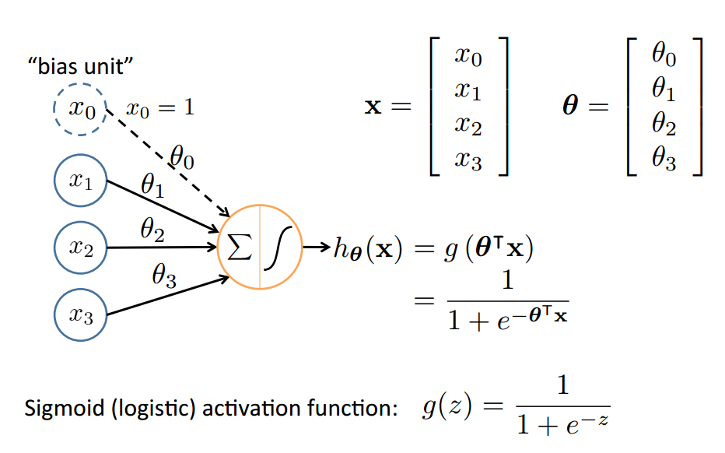
Neuron Model: Logistic Unit
Based on slide by Andrew Ng
10

Slide 6
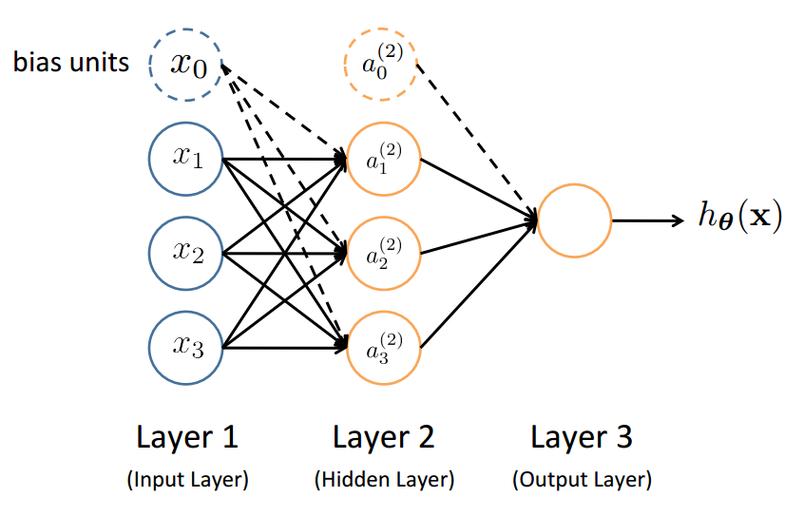
Neural Network
Slide by Andrew Ng
12

Slide 7
Feed-Forward Process
Input layer units are set by some exterior function (think of these as sensors), which causes their output links to be activated at the speciﬁed level
Based on slide by T. Finin, M. desJardins, L Getoor, R. Par
13

Slide 8
Feed-Forward Process
Input layer units are set by some exterior function (think of these as sensors), which causes their output links to be activated at the speciﬁed level
Working forward through the network, the input function of each unit is applied to compute the input value
Usually this is just the weighted sum of the activation on the links feeding into this node
The activation function transforms this input function into a ﬁnal value
Typically this is a nonlinear function, often a sigmoid function corresponding to the “threshold” of that node
Based on slide by T. Finin, M. desJardins, L Getoor, R. Par
13

Slide 9
Feed-Forward Process
Input layer units are set by some exterior function (think of these as sensors), which causes their output links to be activated at the speciﬁed level
Working forward through the network, the input function of each unit is applied to compute the input value
Usually this is just the weighted sum of the activation on the links feeding into this node
The activation function transforms this input function into a ﬁnal value
Typically this is a nonlinear function, often a sigmoid function corresponding to the “threshold” of that node
Based on slide by T. Finin, M. desJardins, L Getoor, R. Par
13

Slide 10
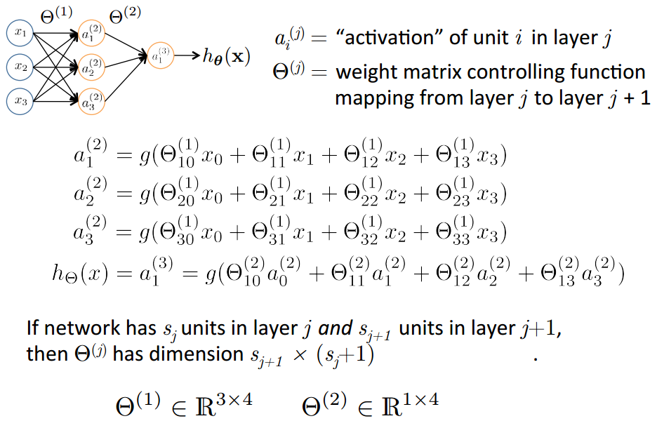
Neural Network
Slide by Andrew Ng
14

Slide 11
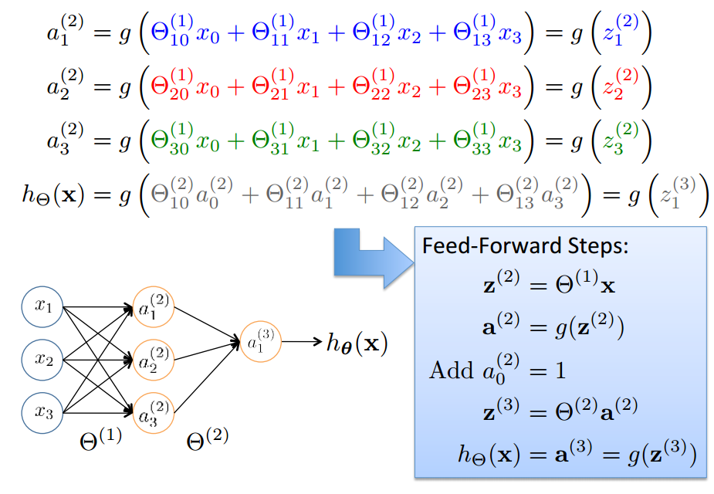
Vectorization
Based on slide by Andrew Ng
15

Slide 12
Understanding Representations
20

Slide 13
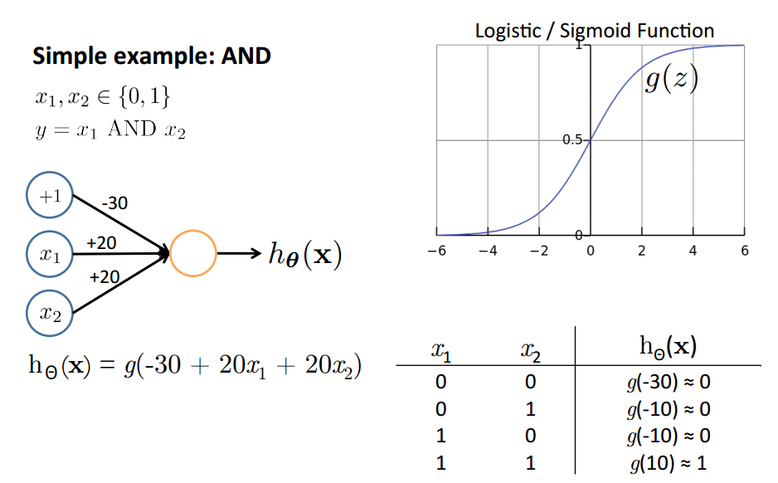
Representing Boolean Functions
Based on slide and example by Andrew Ng
21

Slide 14
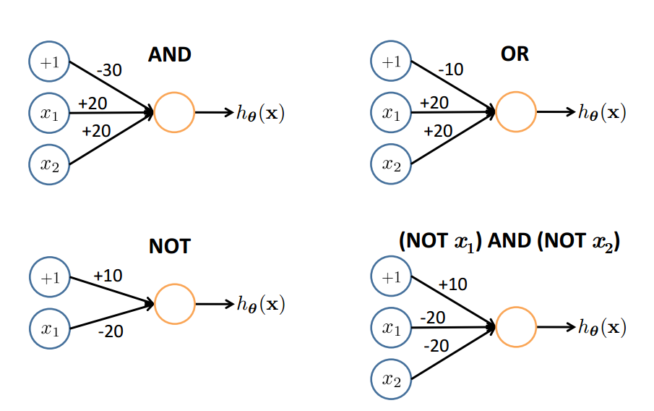
Representing Boolean Functions
OR
22

Slide 15
Representing Boolean Functions
22

Slide 16
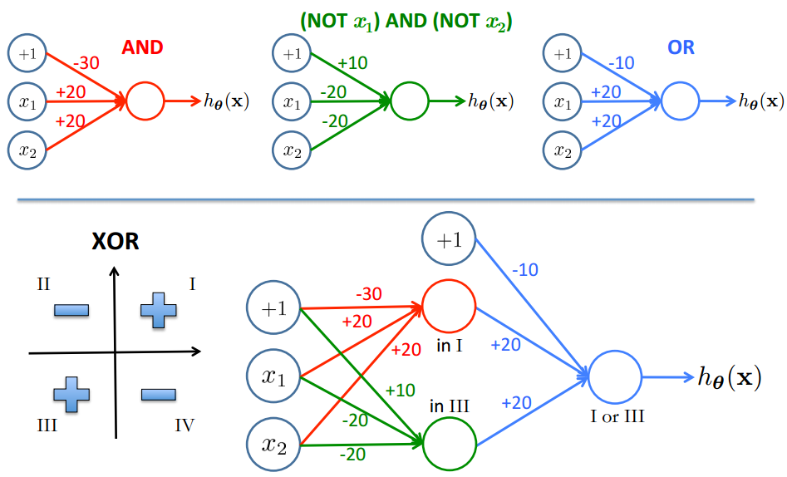

Combining Representations to Create Non-­Linear Functions
$$¬$$
Not XOR
Based on example by Andrew Ng
23

Slide 17
Combining Representations to Create Non-­Linear Functions
$$¬$$
Based on example by Andrew Ng
23

Slide 18
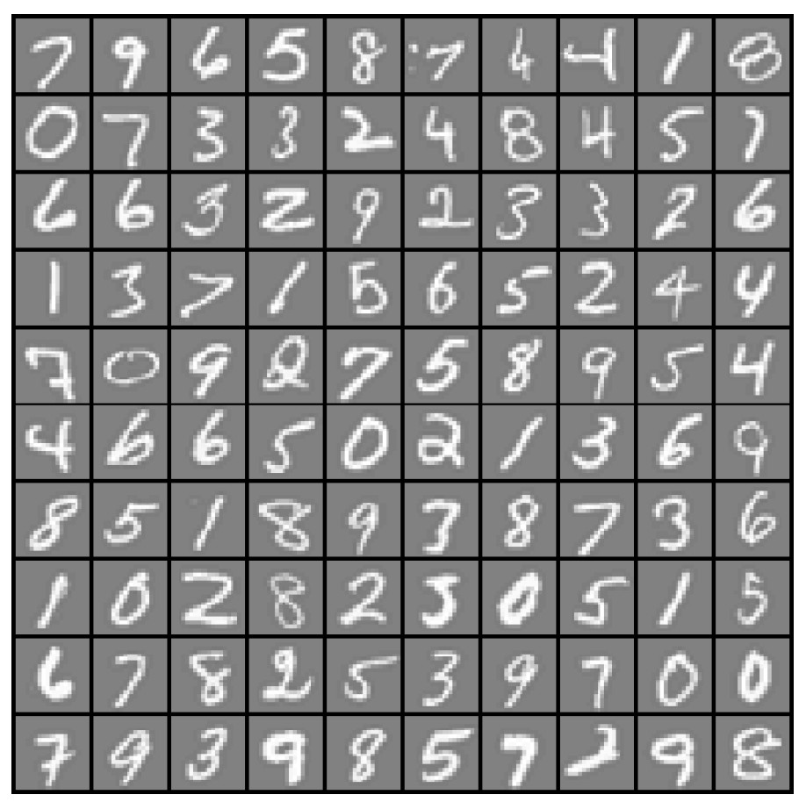

Layering Representations
x₁ ... x₂₀
x₂₁ ... x₄₀
x₄₁ ... x₆₀
...
^{x}381 ^{... x}400
20 × 20 pixel images
d = 400 10 classes
Each image is “unrolled” into a vector x of pixel intensities

Slide 19
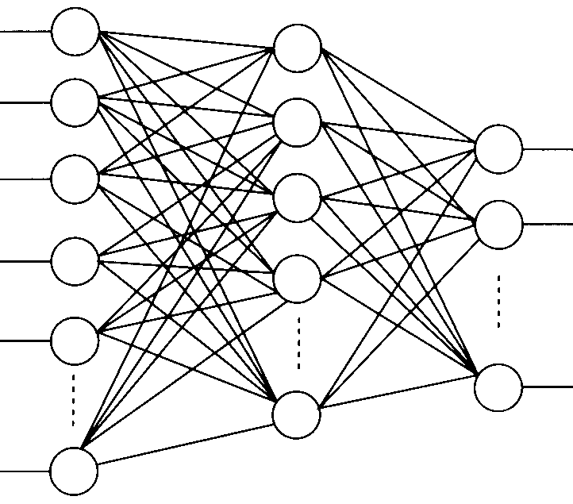
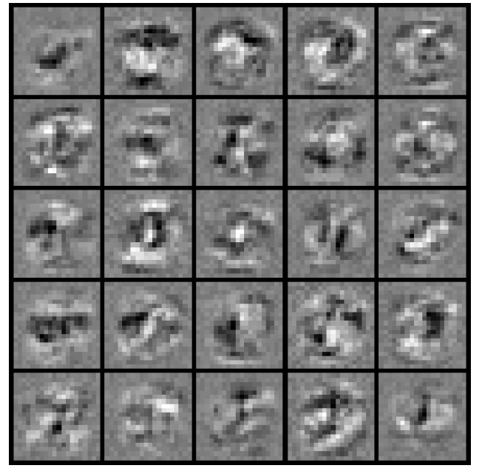
Layering Representations
x₁
x₂
x₃
x₄ x₅
Output Layer
“0”
“1”
“9”
x_{d}
Hidden Layer
Input Layer
Visualization of Hidden Layer

Slide 20
Neural Network Learning

Slide 21
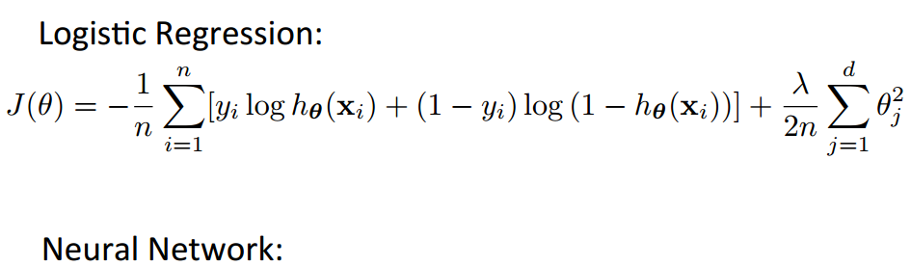
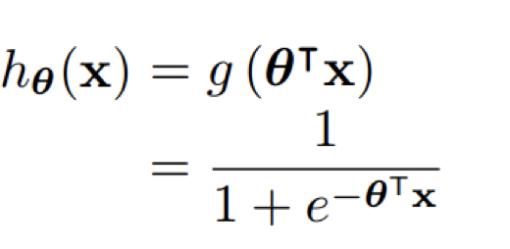
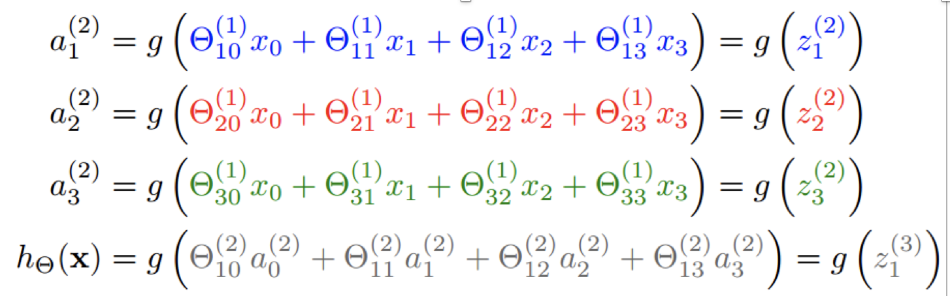
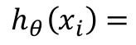
Cost Function
$$h_{θ}\left(x_{i}\right)=$$
Based on slide by Andrew Ng

Slide 22
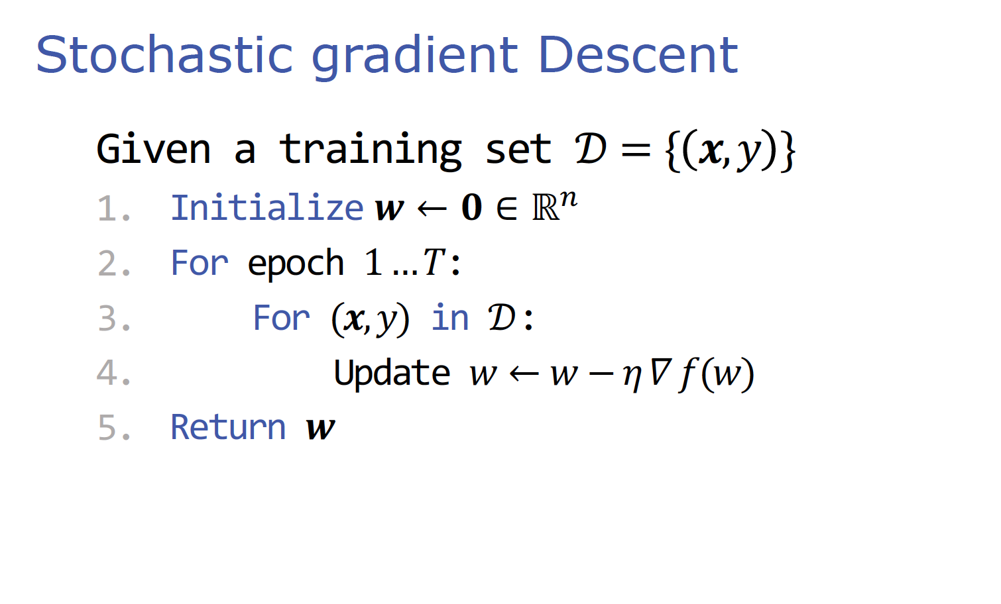
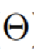
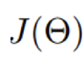
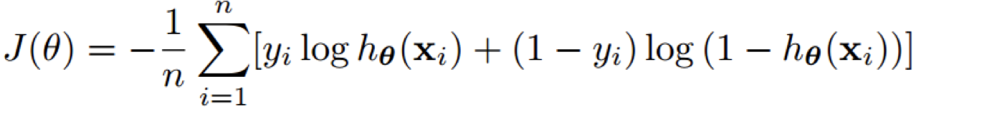
Stochastic gradient Descent
Given a training set n = { m, # }
Initialize [ ← i ∈ ℝ⁵
For epoch 1 … l:
For (m, #) in n:
Update ) ← ) − W ] U())
Return [
We will see more example later in this lecture

Slide 23
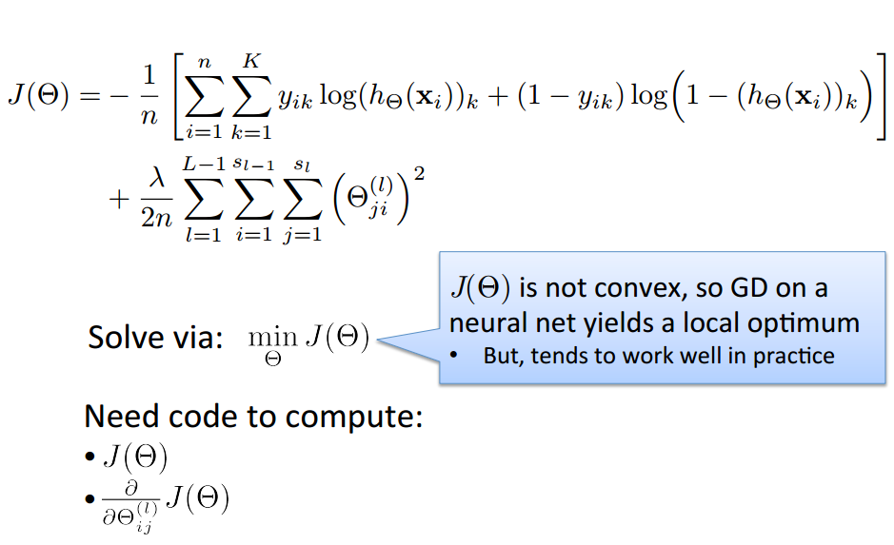
Optimizing the Neural Network
Based on slide by Andrew Ng

Slide 24
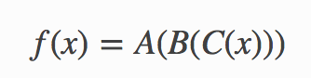
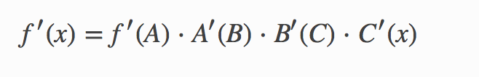
Chain Rule
Given a function
The derivative is

Slide 25
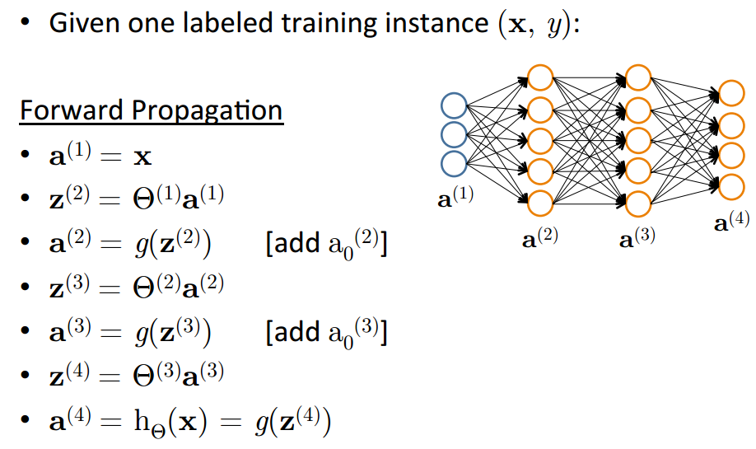
Forward Propagation
Based on slide by Andrew Ng

Slide 26
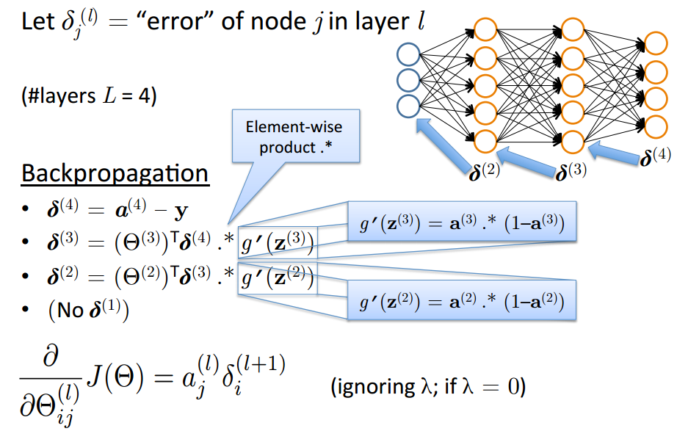
Backpropagation: Gradient Computation
Based on slide by Andrew Ng
41

Slide 27
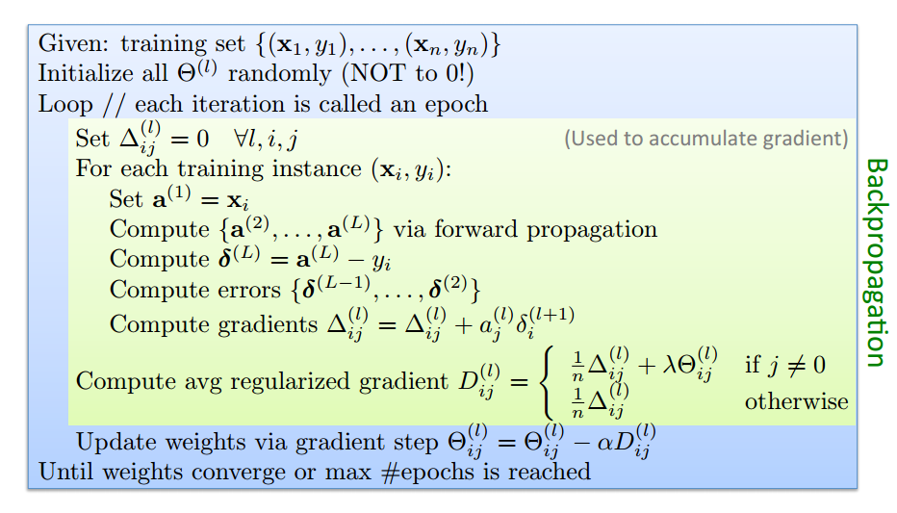
Training a Neural Network via Gradient Descent with Backprop
Based on slide by Andrew Ng

Slide 28
How to deal with input with variant size?
Use same parameters
Today is a … </S>
<S> Today is … day

Slide 29
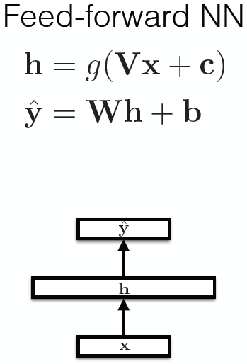
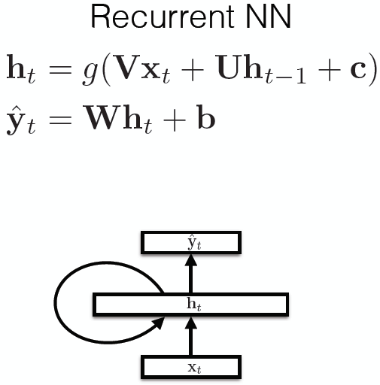
Recurrent Neural Networks

Slide 30
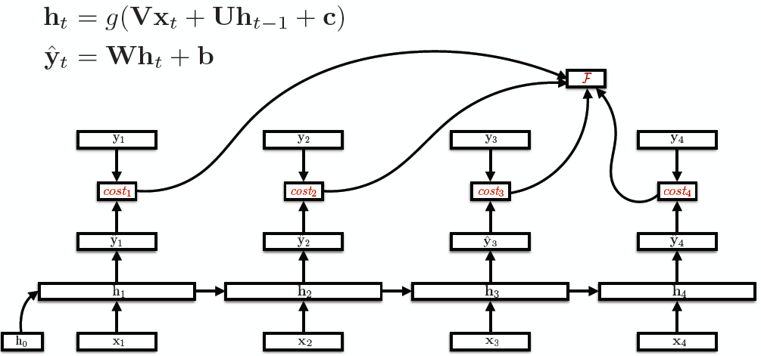
Unroll RNNs
U
V

Slide 31
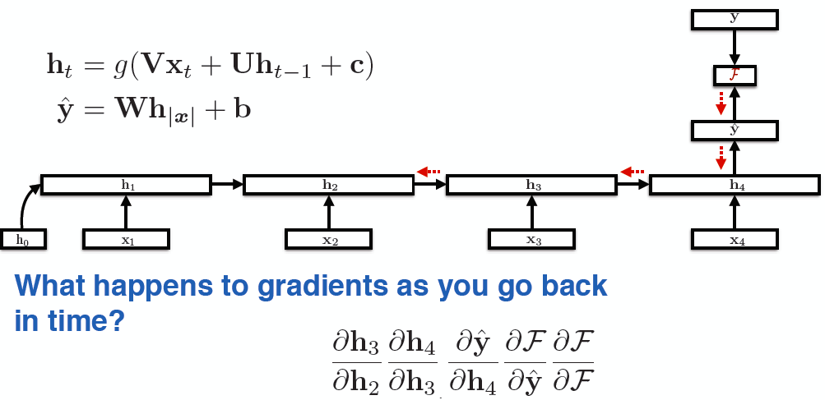
RNN training
Back-propagation over time

Slide 32
Midterm
11/5 in class.
No book, note, laptop
Sample questions will be posted online
From Lecture 1 to this slide.

Slide 33
Any Question?

Slide 34
This lecture: Computational Learning Theory
The Theory of Generalization
Probably Approximately Correct (PAC) learning
Shattering and the VC dimension

Slide 35
The Theory of Generalization
The Theory of Generalization
When can be trust the learning algorithm?
What functions can be learned?
What is the meaning of learning

Slide 36
Computational Learning Theory
Are there general “laws of nature” related to learnability?
We want theory that can relate
Probability of successful learning
Number of training examples
Complexity of hypothesis space
Accuracy to which target concept is approximated
Manner in which training examples are presented

Slide 37
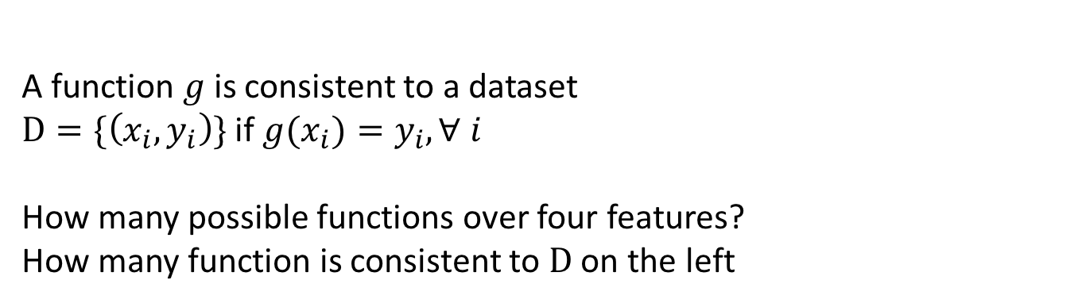
A Learning Problem
x1
x2
Unknown
function
x3
y = f (x1, x2, x3, x4)
x4
Example
x1 x2 x3 x4 y
Can you learn this function?
What is it?
1 0 0 1 0 0
2 0 1 0 0 0
3 0 0 1 1 1
A function $g$is consistent to a dataset $D=\{\left(x_{i}, y_{i}\right)\}$ if ${g(x}_{i})=y_{i}, ∀ i$
How many possible functions over four features?
How many function is consistent to $D$ on the left
4 1 0 0 1 1
5 0 1 1 0 0
6 1 1 0 0 0
7 0 1 0 1 0

Slide 38
Hypothesis Space
Complete Ignorance:
There are 2¹⁶ = 65536 possible functions
over four input features.
We can’t figure out which one is
correct until we’ve seen every
possible input-output pair.
After observing seven examples we still
have 2⁹ possibilities for f
Is Learning Possible?
Example
x1 x2 x3 x4 y
0 0 0 0 ?
0 0 0 1 ?
0 0 1 0 0
0 0 1 1 1
0 1 0 0 0
0 1 0 1 0
0 1 1 0 0
0 1 1 1 ?
1 0 0 0 ?
1 0 0 1 0
1 0 1 0 ?
1 0 1 1 ?
1 1 0 0 0
1 1 0 1 ?
1 1 1 0 ?
1 1 1 1 ?
Notes:
Badges game
Don’t give me the answer
Start thinking about how to write a program that will figure out whether my name has + or – next to it.

Slide 39
Hypothesis Space
Complete Ignorance:
There are 2¹⁶ = 65536 possible functions
over four input features.
We can’t figure out which one is
correct until we’ve seen every
possible input-output pair.
After observing seven examples we still
have 2⁹ possibilities for f
Is Learning Possible?
Example
x1 x2 x3 x4 y
0 0 0 0 ?
0 0 0 1 ?
0 0 1 0 0
0 0 1 1 1
There are |Y|^{|X|} possible functions f(x) from the instance space X to the label space Y.
Learners typically consider only a subset of the functions from X to Y, called the hypothesis space H . H ⊆|Y|^{|X|}
0 1 0 0 0
0 1 0 1 0
0 1 1 0 0
0 1 1 1 ?
1 0 0 0 ?
1 0 0 1 0
1 0 1 0 ?
1 0 1 1 ?
1 1 0 0 0
1 1 0 1 ?
1 1 1 0 ?
1 1 1 1 ?
Notes:
Badges game
Don’t give me the answer
Start thinking about how to write a program that will figure out whether my name has + or – next to it.

Slide 40
Hypothesis Space
1 0 0 1 0 0
2 0 1 0 0 0
3 0 0 1 1 1
4 1 0 0 1 0
5 0 1 1 0 0
6 1 1 0 0 0
7 0 1 0 1 0
Simple Rules: There are only 16 simple conjunctive rules
of the form y=x_{i} Λ x_{j} Λ x_{k} Λ x_{p}
No simple rule explains the data. The same is true for simple clauses.
Rule Counterexample
Rule Counterexample
y=c 1100 0
x1 1100 0
x2 0100 0
x3 0110 0
x4 0101 1
x1 Λ x2 1100 0
x1 Λ x3 0011 1
x1 Λ x4 0011 1
x2 Λ x3 0011 1
x2 Λ x4 0011 1
x3 Λ x4 OK
x1 Λ x2 Λ x3 0011 1
x1 Λ x2 Λ x4 0011 1
x1 Λ x3 Λ x4 0011 1
x2 Λ x3 Λ x4 0011 1
x1 Λ x2 Λ x3 Λ x4 0011 1
Notes:
Badges game
Don’t give me the answer
Start thinking about how to write a program that will figure out whether my name has + or – next to it.

Slide 41
Hypothesis Space
1 0 0 1 0 0
2 0 1 0 0 0
3 0 0 1 1 1
4 1 0 0 1 0
5 0 1 1 0 0
6 1 1 0 0 0
7 0 1 0 1 0
Simple Rules: There are only 16 simple conjunctive rules
of the form y=x_{i} Λ x_{j} Λ x_{k} Λ x_{p}
No simple rule explains the data. The same is true for simple clauses.
Rule Counterexample
Rule Counterexample
y=c 1100 0
x1 1100 0
x2 0100 0
x3 0110 0
x4 0101 1
x1 Λ x2 1100 0
x1 Λ x3 0011 1
x1 Λ x4 0011 1
x2 Λ x3 0011 1
x2 Λ x4 0011 1
x3 Λ x4 OK
x1 Λ x2 Λ x3 0011 1
x1 Λ x2 Λ x4 0011 1
x1 Λ x3 Λ x4 0011 1
x2 Λ x3 Λ x4 0011 1
x1 Λ x2 Λ x3 Λ x4 0011 1
Notes:
Badges game
Don’t give me the answer
Start thinking about how to write a program that will figure out whether my name has + or – next to it.

Slide 42
Hypothesis Space
1 0 0 1 0 0
2 0 1 0 0 0
3 0 0 1 1 1
4 1 0 0 1 0
5 0 1 1 0 0
6 1 1 0 0 0
7 0 1 0 1 0
Simple Rules: There are only 16 simple conjunctive rules
of the form y=x_{i} Λ x_{j} Λ x_{k} Λ x_{p}
No simple rule explains the data. The same is true for simple clauses.
Rule Counterexample
Rule Counterexample
y=c 1100 0
x1 1100 0
x2 0100 0
x3 0110 0
x4 0101 1
x1 Λ x2 1100 0
x1 Λ x3 0011 1
x1 Λ x4 0011 1
x2 Λ x3 0011 1
x2 Λ x4 0011 1
x3 Λ x4 OK
x1 Λ x2 Λ x3 0011 1
x1 Λ x2 Λ x4 0011 1
x1 Λ x3 Λ x4 0011 1
x2 Λ x3 Λ x4 0011 1
x1 Λ x2 Λ x3 Λ x4 0011 1
How many examples we need to figure out the right function?
Notes:
Badges game
Don’t give me the answer
Start thinking about how to write a program that will figure out whether my name has + or – next to it.

Slide 43
Learning protocol
Provide the learning examples
Learn the model

Slide 44
Learning Monotone Conjunctions
Protocol 1: Teacher provides a set of example (x, f(x))
<(1,1,1,1,1,1,…,1,1), 1>
<(1,1,1,0,0,0,…,0,0), 0>
<(1,1,1,1,1,0,...0,1,1), 1>
<(1,0,1,1,1,0,...0,1,1), 0>
<(1,1,1,1,1,0,...0,0,1), 1>
<(1,0,1,0,0,0,...0,1,1), 0>
<(1,1,1,1,1,1,…,0,1), 1>
<(0,1,0,1,0,0,...0,1,1), 0>

Slide 45
Learning Monotone Conjunctions
Student: Elimination algorithm
Start with the set of all literals as candidates
Eliminate a literal that is not active (0) in a positive example
<(1,1,1,1,1,1,…,1,1), 1>
<(1,1,1,0,0,0,…,0,0), 0>
<(1,1,1,1,1,0,...0,1,1), 1>
<(1,0,1,1,1,0,...0,1,1), 0>
<(1,1,1,1,1,0,...0,0,1), 1>
<(1,0,1,0,0,0,...0,1,1), 0>
<(1,1,1,1,1,1,…,0,1), 1>
<(0,1,0,1,0,0,...0,1,1), 0>
Learn nothing
Learn nothing
Learn nothing
We can determine the # of mistakes we’ll make before reaching the exact target function, but not how many examples are need to guarantee good performance.

Slide 46
Learning Monotone Conjunctions
Protocol 2: Alternatively, we can have the learner to propose instances as queries to the teacher
Since we know we have a Monotone conjunction:
Is x₁₀₀ in? <(1,1,1…,1,0), ?> f(x)=0 (conclusion: Yes)
Is x₉₉ in? <(1,1,…1,0,1), ?> f(x)=1 (conclusion: No)
Is x₁ in ? <(0,1,…1,1,1), ?> f(x)=1 (conclusion: No)
A straight forward algorithm requires n=100 queries, and will produce as a result the hidden conjunction (exactly).

Slide 47
Learning Monotone Conjunctions
Protocol 2: Alternatively, we can have the learner to propose instances as queries to the teacher
Since we know we have a Monotone conjunction:
Is x₁₀₀ in? <(1,1,1…,1,0), ?> f(x)=0 (conclusion: Yes)
Is x₉₉ in? <(1,1,…1,0,1), ?> f(x)=1 (conclusion: No)
Is x₁ in ? <(0,1,…1,1,1), ?> f(x)=1 (conclusion: No)
A straight forward algorithm requires n=100 queries, and will produce as a result the hidden conjunction (exactly).
This style of protocol called active learning.
We will not cover it in this class.
Lesson: Based on different setting, we can get different guarantees

Slide 48
Two Models
for How good is our learning algorithm?
Analyze the probabilistic intuition
Never saw a feature in positive examples, maybe we’ll never see it
And if we do, it will be with small probability, so the concepts we learn may be pretty good
Pretty good: In terms of performance on future data
PAC framework
Mistake Driven Learning algorithms
Update your hypothesis only when you make mistakes
Define good in terms of how many mistakes you make before you stop
Online learning

Slide 49
The mistake-bound approach
The mistake bound model is a theoretical approach
We can determine the number of mistakes the learning algorithm can make before converging
But no answer to “How many examples do you need before converging to a good hypothesis?”
Because the mistake-bound model makes no assumptions about the order or distribution of training examples
Both a strength and a weakness of the mistake bound model

Slide 50
PAC learning
A model for batch learning
Train on a fixed training set
Then deploy it in the wild
How well will your learning algorithm do on future instances?

Slide 51
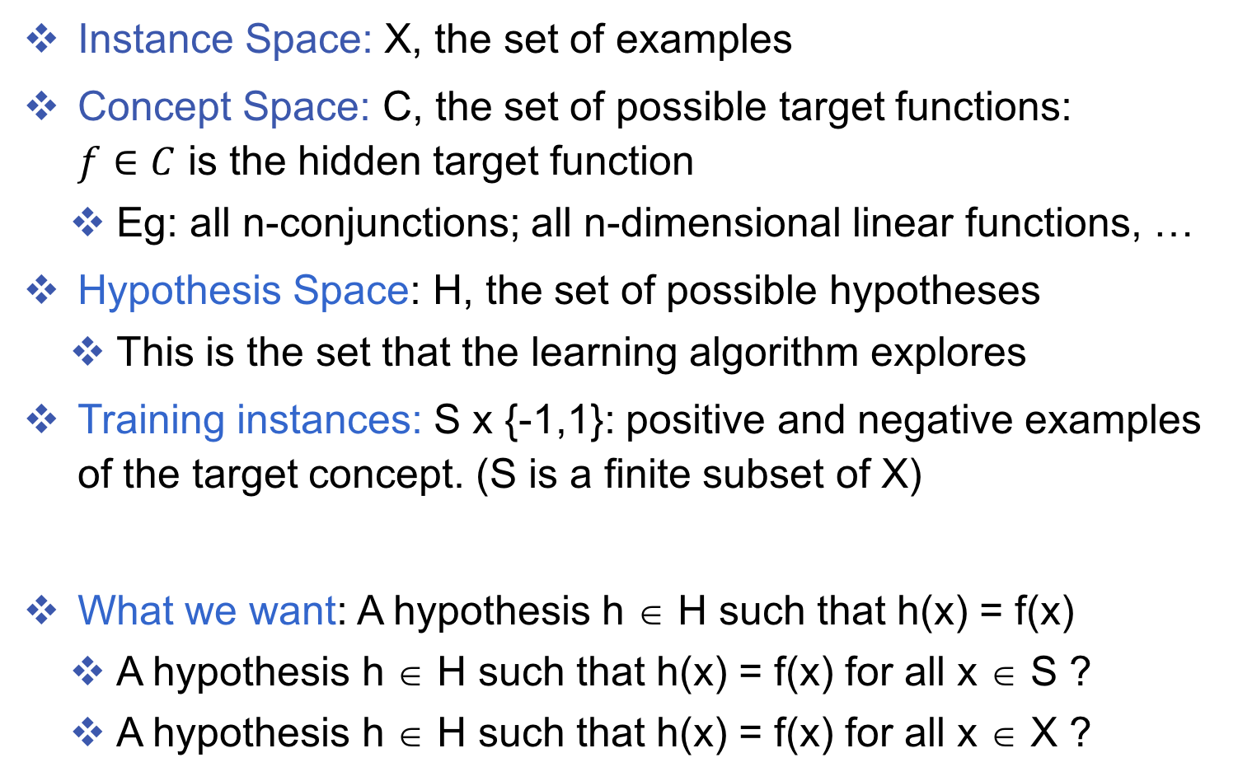
The setup
Instance Space: X, the set of examples
Concept Space: C, the set of possible target functions: $f∈C$ is the hidden target function
Eg: all n-conjunctions; all n-dimensional linear functions, …
Hypothesis Space: H, the set of possible hypotheses
This is the set that the learning algorithm explores
Training instances: S x {-1,1}: positive and negative examples of the target concept. (S is a finite subset of X)
What we want: A hypothesis h ∈ H such that h(x) = f(x)
A hypothesis h ∈ H such that h(x) = f(x) for all x ∈ S ?
A hypothesis h ∈ H such that h(x) = f(x) for all x ∈ X ?

Slide 52
Learning monotone Conjunctions
Protocol 1: Teacher provides a set of example (x, f(x))
<(1,1,1,1,1,1,…,1,1), 1>
<(1,1,1,0,0,0,…,0,0), 0>
<(1,1,1,1,1,0,...0,1,1), 1>
<(1,0,1,1,1,0,...0,1,1), 0>
<(1,1,1,1,1,0,...0,0,1), 1>
<(1,0,1,0,0,0,...0,1,1), 0>
<(1,1,1,1,1,1,…,0,1), 1>
<(0,1,0,1,0,0,...0,1,1), 0>
Assumption: data are sample from a fixed distribution
What would f look like?

Slide 53
PAC Learning – Intuition
The assumption of fixed distribution is important:
What we learn on the training data will be meaningful on future examples
Also gives a well-defined notion of the error of a hypothesis according to the target function

Slide 54
Learning Conjunctions
Protocol 1: Teacher provides a set of example (x, f(x))
<(1,1,1,1,1,1,…,1,1), 1>
<(1,1,1,0,0,0,…,0,0), 0>
<(1,1,1,1,1,0,...0,1,1), 1>
<(1,0,1,1,1,0,...0,1,1), 0>
<(1,1,1,1,1,0,...0,0,1), 1>
<(1,0,1,0,0,0,...0,1,1), 0>
<(1,1,1,1,1,1,…,0,1), 1>
<(0,1,0,1,0,0,...0,1,1), 0>
What would f look like?
Whenever the output is 1, x₁ is present
With the given data, we only learned an approximation to the true concept.
Is it good enough?

Slide 55
“The future will be like the past”:
We have seen many examples (drawn according to the distribution D)
Since in all the positive examples x₁ was active, it is very likely that it will be active in future positive examples
Otherwise, x₁ is active only in a small percentage of the examples so our error will be small

Slide 56
Error of a hypothesis
Definition
Given a distribution D over examples, the error of a hypothesis h with respect to a target concept f is
err_{D}(h) = Pr_{x ~ D}[h(x) ≠ f(x)]

Slide 57
Error of a hypothesis
Definition
Given a distribution D over examples, the error of a hypothesis h with respect to a target concept f is
err_{D}(h) = Pr_{x ~ D}[h(x) ≠ f(x)]
Instance space X

Slide 58
Error of a hypothesis
Definition
Given a distribution D over examples, the error of a hypothesis h with respect to a target concept f is
err_{D}(h) = Pr_{x ~ D}[h(x) ≠ f(x)]
Instance space X
Target concept f labels all these points as positive

Slide 59
Error of a hypothesis
Definition
Given a distribution D over examples, the error of a hypothesis h with respect to a target concept f is
err_{D}(h) = Pr_{x ~ D}[h(x) ≠ f(x)]
Instance space X
A hypothesis h labels all these points as positive
Target concept f labels all these points as positive

Slide 60
Error of a hypothesis
Definition
Given a distribution D over examples, the error of a hypothesis h with respect to a target concept f is
err_{D}(h) = Pr_{x ~ D}[h(x) ≠ f(x)]
Instance space X
A hypothesis h labels all these points as positive
Target concept f labels all these points as positive
Error: f and h disagree

Slide 61
Empirical error
Contrast true error against the empirical error
For a target concept f, the empirical error of a hypothesis h is defined for a training set S as the fraction of examples x in S for which the functions f and h disagree.
Denoted by err_{S}(h)
Overfitting: When the empirical error on the training set err_{S}(h) is substantially lower than err_{D}(h)

Slide 62
The goal of learning
To devise good learning algorithms that avoid overfitting
Not fooled by functions that only appear to be good because they explain the training set very well
Instance space X
Instance space X

Slide 63
This lecture: Computational Learning Theory
The Theory of Generalization
Probably Approximately Correct (PAC) learning
Shattering and the VC dimension

Slide 64
Probably Approximately Correct (PAC) learning
Analyze a simple algorithm for learning monotone conjunctions
Define the PAC model of learning

Slide 65
Example: Learning Monotone Conjunctions
The true function
Training data
<(1,1,1,1,1,1,…,1,1), 1>
<(1,1,1,0,0,0,…,0,0), 0>
<(1,1,1,1,1,0,...0,1,1), 1>
<(1,0,1,1,1,0,...0,1,1), 0>
<(1,1,1,1,1,0,...0,0,1), 1>
<(1,0,1,0,0,0,...0,1,1), 0>
<(1,1,1,1,1,1,…,0,1), 1>
<(0,1,0,1,0,0,...0,1,1), 0>

Slide 66
Learning Conjunctions
Training data
<(1,1,1,1,1,1,…,1,1), 1>
<(1,1,1,0,0,0,…,0,0), 0>
<(1,1,1,1,1,0,...0,1,1), 1>
<(1,0,1,1,1,0,...0,1,1), 0>
<(1,1,1,1,1,0,...0,0,1), 1>
<(1,0,1,0,0,0,...0,1,1), 0>
<(1,1,1,1,1,1,…,0,1), 1>
<(0,1,0,1,0,0,...0,1,1), 0>
A simple learning algorithm (Elimination)
Discard all negative examples

Slide 67
Learning Conjunctions
Training data
<(1,1,1,1,1,1,…,1,1), 1>
<(1,1,1,0,0,0,…,0,0), 0>
<(1,1,1,1,1,0,...0,1,1), 1>
<(1,0,1,1,1,0,...0,1,1), 0>
<(1,1,1,1,1,0,...0,0,1), 1>
<(1,0,1,0,0,0,...0,1,1), 0>
<(1,1,1,1,1,1,…,0,1), 1>
<(0,1,0,1,0,0,...0,1,1), 0>
A simple learning algorithm (Elimination)
Discard all negative examples
Build a conjunction using the features that are common to all positive conjunctions

Slide 68
Learning Conjunctions
Training data
<(1,1,1,1,1,1,…,1,1), 1>
<(1,1,1,0,0,0,…,0,0), 0>
<(1,1,1,1,1,0,...0,1,1), 1>
<(1,0,1,1,1,0,...0,1,1), 0>
<(1,1,1,1,1,0,...0,0,1), 1>
<(1,0,1,0,0,0,...0,1,1), 0>
<(1,1,1,1,1,1,…,0,1), 1>
<(0,1,0,1,0,0,...0,1,1), 0>
A simple learning algorithm (Elimination)
Discard all negative examples
Build a conjunction using the features that are common to all positive conjunctions
Positive examples eliminate irrelevant features

Slide 69
Learning Conjunctions
Training data
<(1,1,1,1,1,1,…,1,1), 1>
<(1,1,1,0,0,0,…,0,0), 0>
<(1,1,1,1,1,0,...0,1,1), 1>
<(1,0,1,1,1,0,...0,1,1), 0>
<(1,1,1,1,1,0,...0,0,1), 1>
<(1,0,1,0,0,0,...0,1,1), 0>
<(1,1,1,1,1,1,…,0,1), 1>
<(0,1,0,1,0,0,...0,1,1), 0>
A simple learning algorithm:
Discard all negative examples
Build a conjunction using the features that are common to all positive conjunctions
Clearly this algorithm produces a conjunction that is consistent with the data, that is err_{S}(h) = 0, if the target function is a monotone conjunction

Slide 70
Learning Conjunctions
Training data
<(1,1,1,1,1,1,…,1,1), 1>
<(1,1,1,0,0,0,…,0,0), 0>
<(1,1,1,1,1,0,...0,1,1), 1>
<(1,0,1,1,1,0,...0,1,1), 0>
<(1,1,1,1,1,0,...0,0,1), 1>
<(1,0,1,0,0,0,...0,1,1), 0>
<(1,1,1,1,1,1,…,0,1), 1>
<(0,1,0,1,0,0,...0,1,1), 0>
A simple learning algorithm:
Discard all negative examples
Build a conjunction using the features that are common to all positive conjunctions
Does the true error err_{D}(h) also 0?
Clearly this algorithm produces a conjunction that is consistent with the data, that is err_{S}(h) = 0, if the target function is a monotone conjunction

Slide 71
Learning Conjunctions: Analysis
Claim 1: Any hypothesis consistent with the training data will only make mistakes on positive future examples
-
f
A mistake will occur only if some literal z (in our example x₁) is present in h but not in f
This mistake can cause a positive example to be predicted as negative by h
The reverse situation can never happen
For an example to be predicted as positive in the training set, every relevant literal must have been present
+
h
+
-
-
Specifically: x₁ = 0, x₂ =1, x₃=1, x₄=1, x₅=1, x₁₀₀=1

Slide 72
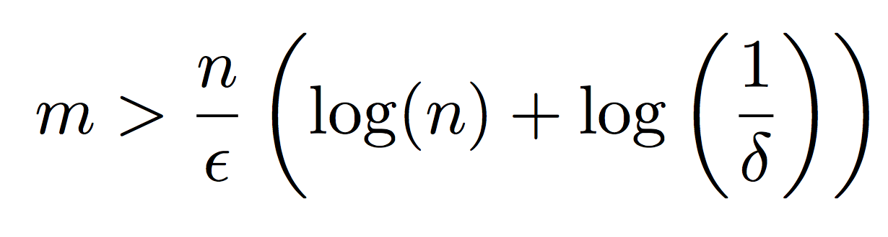
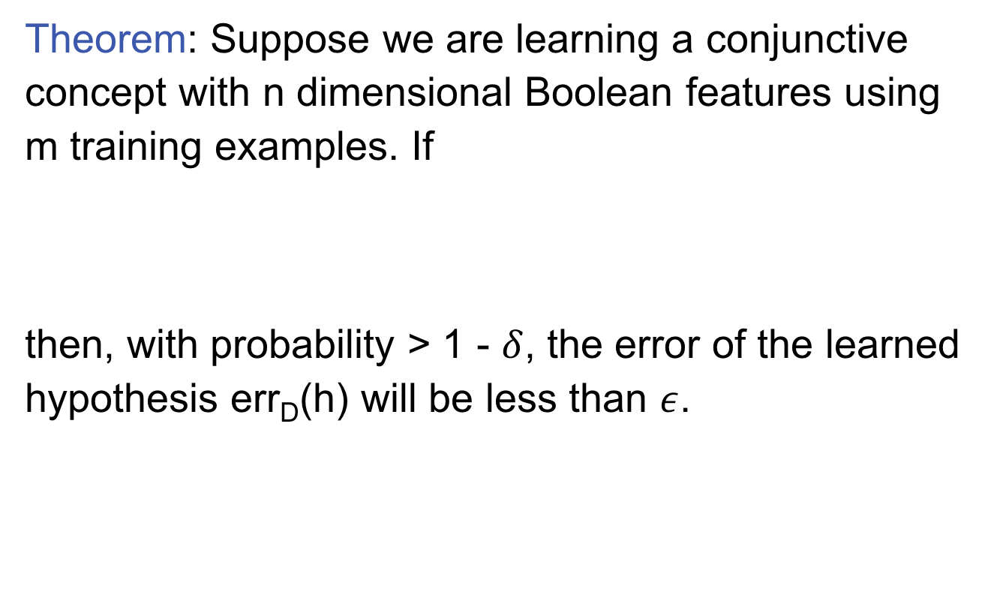
Learning Conjunctions: Analysis
Theorem: Suppose we are learning a conjunctive concept with n dimensional Boolean features using m training examples. If
then, with probability > 1 - $δ$, the error of the learned hypothesis err_{D}(h) will be less than $ε$.

Slide 73
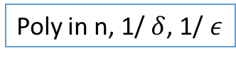
Learning Conjunctions: Analysis
Theorem: Suppose we are learning a conjunctive concept with n dimensional Boolean features using m training examples. If
then, with probability > 1 - $δ$, the error of the learned hypothesis err_{D}(h) will be less than $ε$.
Poly in n, 1/ $δ$, 1/ $ε$
n: # literals
If we see these many training examples, then the algorithm will produce a conjunction that, with high probability, will make few errors

Slide 74
Learning Conjunctions: Analysis
Theorem: Suppose we are learning a conjunctive concept with n dimensional Boolean features using m training examples. If
then, with probability > 1 - $δ$, the error of the learned hypothesis err_{D}(h) will be less than $ε$.
Poly in n, 1/ $δ$, 1/ $ε$
Let’s prove this assertion

Slide 75
Proof Intuition
What kinds of examples would drive a hypothesis to make a mistake and update?
Positive examples, where x₁ = 0
h would say true and f would say false
None of these examples appeared during training
Otherwise x₁ would have been eliminated
If they never appeared during training, maybe their appearance in the future would also be rare!
Let’s quantify our surprise at seeing such examples

Slide 76
Proof Intuition
What kinds of examples would drive a hypothesis to make a mistake and update?
Positive examples, where x₁ = 0
h would say true and f would say false
None of these examples appeared during training
Otherwise x₁ would have been eliminated
If they never appeared during training, maybe their appearance in the future would also be rare!
Let’s quantify our surprise at seeing such examples
Key idea: If they never appeared during training, they are not likely to appear in test as well

Slide 77
Learning Conjunctions: Analysis
Let p(z) be the probability that, in an example drawn from D, the feature z = 0 but the example has a positive label
In the training – this is an example that can help we learn the right h
In the test – this is an example that make an error
<(1,1,1,1,1,1,…,1,1), 1>
<(1,1,1,1,1,0,...0,1,1), 1>
<(1,1,1,1,1,0,...0,0,1), 1>
<(1,1,1,1,1,1,…,0,1), 1>

Slide 78
Learning Conjunctions: Analysis
Let p(z) be the probability that, in an example drawn from D, the feature z=0 but the example has a positive label
i.e., after training is done, p(z) is the probability that in a randomly drawn example, the literal z causes a mistake
For any z in the target function, p(z) = 0
<(0,1,1,1,1,0,...0,1,1), 1>
p(x₁): Probability that this situation occurs

Slide 79
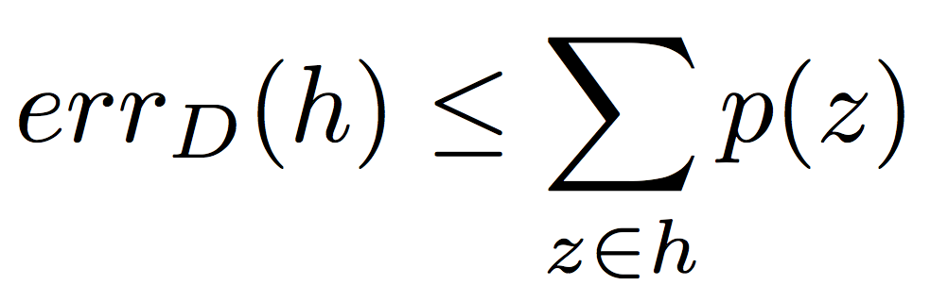
How likely we find h is wrong
Let p(z) be the probability that, in an example drawn from D, the feature z is absent but the example has a positive label
We know that
Via direct application of the union bound
This is a loose bound

Slide 80
How likely we find h is wrong
Let p(z) be the probability that, in an example drawn from D, the feature z is absent but the example has a positive label
We know that
Via direct application of the union bound
This is a loose bound
Union bound
For a set of events, probability that at least one of them happens < the sum of the probabilities of the individual events

Slide 81
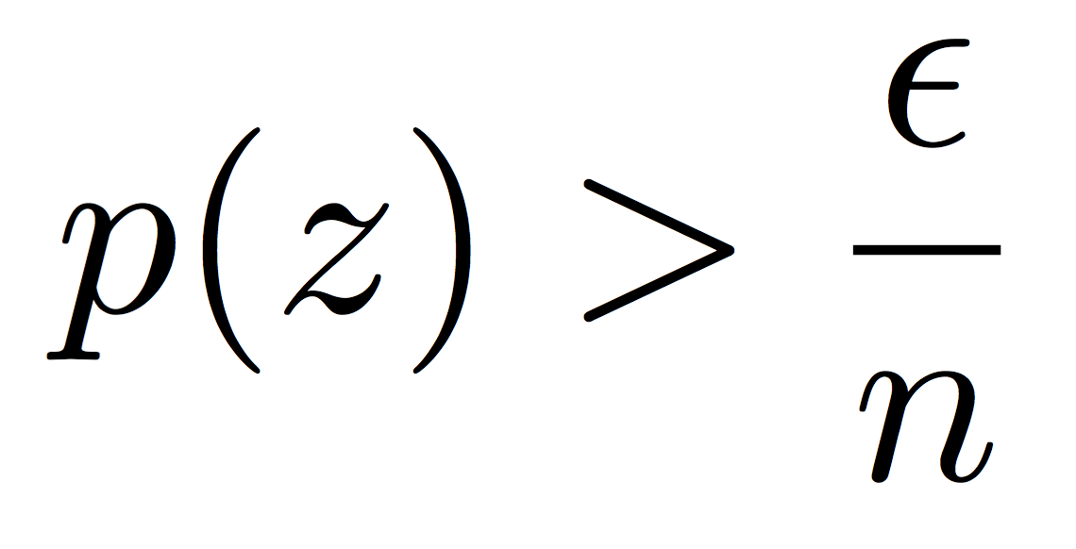
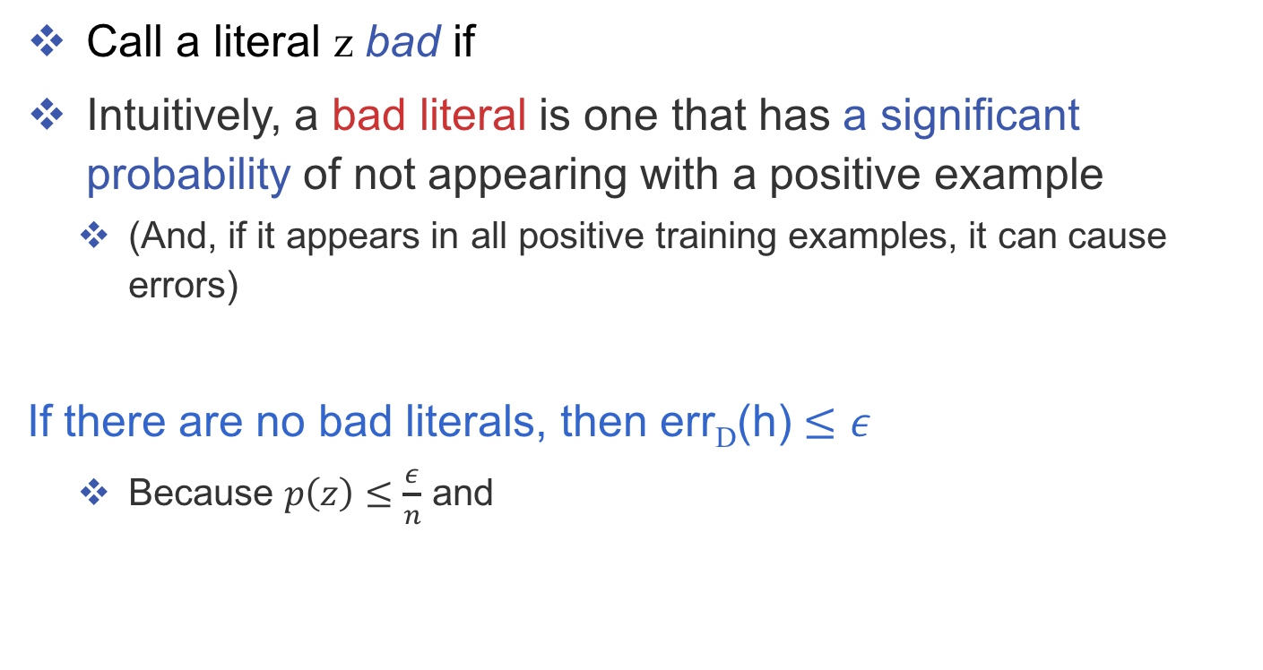
Learning Conjunctions: Analysis
n = dimensionality
Call a literal z bad if
Intuitively, a bad literal is one that has a significant probability of not appearing with a positive example
(And, if it appears in all positive training examples, it can cause errors)
If there are no bad literals, then err_{D}(h) $≤ε$
Because $p\left(z\right)≤\frac{ε}{n}$ and

Slide 82
Learning Conjunctions: Analysis
n = dimensionality
Call a literal z bad if
Intuitively, a bad literal is one that has a significant probability of not appearing with a positive example
(And, if it appears in all positive training examples, it can cause errors)
What if there are bad literals?
Let z be a bad literal
What is the probability that it will not be eliminated by one training example?
There was one example of this kind
<(1,1,1,1,1,0,...0,1,1), 1>

Slide 83
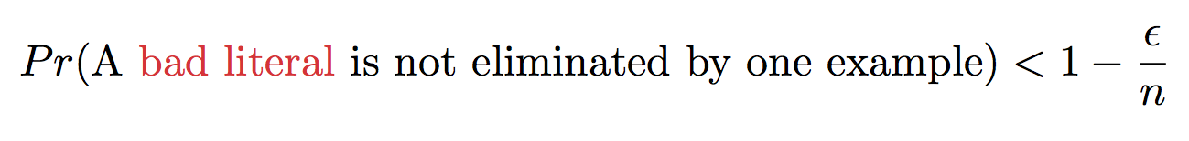
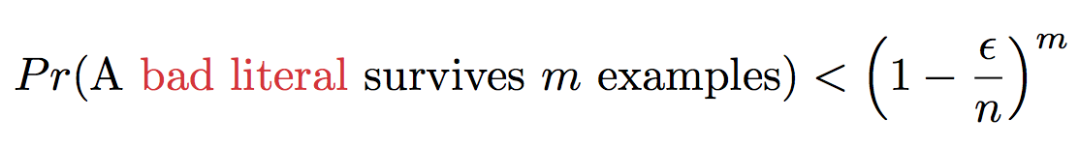
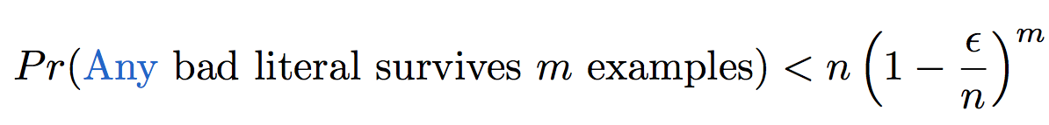
Learning Conjunctions: Analysis
n = dimensionality
What we know so far:
But say we have m training examples. Then
There are at most n bad literals. So

Slide 84
Learning Conjunctions: Analysis
n = dimensionality
What we know so far:
But say we have m training examples. Then
There are at most n bad literals. So

Slide 85
Learning Conjunctions: Analysis
n = dimensionality
What we know so far:
But say we have m training examples. Then
There are at most n bad literals. So

Slide 86
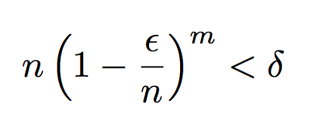
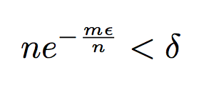
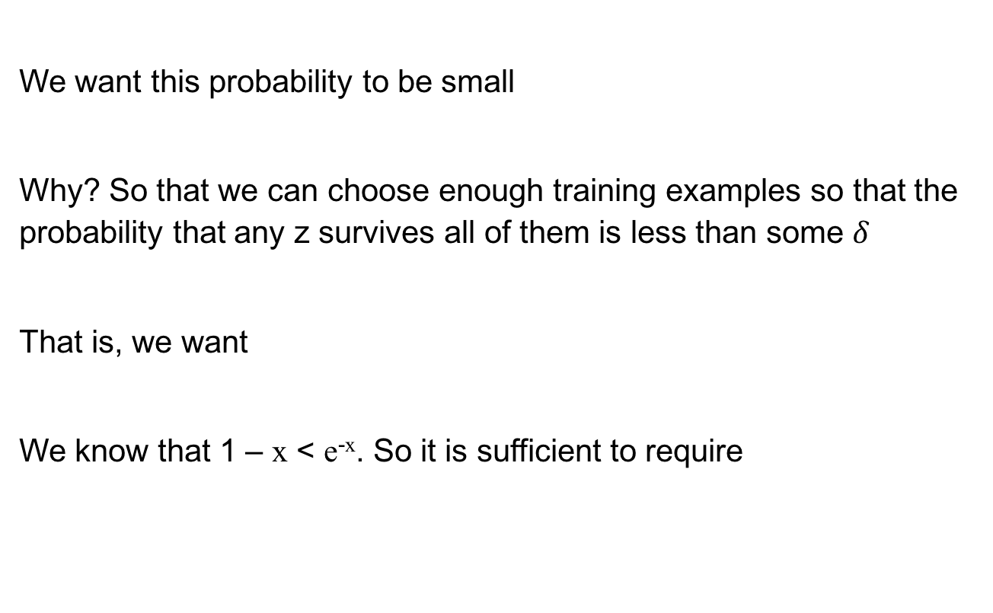
Learning Conjunctions: Analysis
We want this probability to be small
Why? So that we can choose enough training examples so that the probability that any z survives all of them is less than some $δ$
That is, we want
We know that 1 – x < e^{-x}. So it is sufficient to require

Slide 87
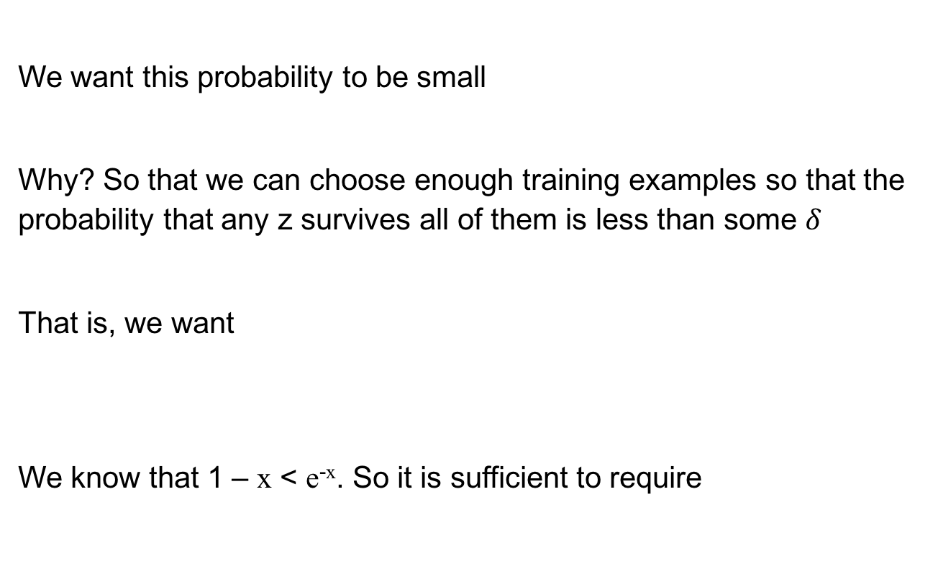
Learning Conjunctions: Analysis
We want this probability to be small
Why? So that we can choose enough training examples so that the probability that any z survives all of them is less than some $δ$
That is, we want
We know that 1 – x < e^{-x}. So it is sufficient to require

Slide 88
Learning Conjunctions: Analysis
We want this probability to be small
Why? So that we can choose enough training examples so that the probability that any z survives all of them is less than some ±
That is, we want
We know that 1 – x < e^{-x}. So it is sufficient to require
Or equivalently,

Slide 89
Learning Conjunctions: Analysis
Theorem: Suppose we are learning a conjunctive concept with n dimensional Boolean features using m training examples. If
then, with probability > 1 - $δ$, the error of the learned hypothesis err_{D}(h) will be less than $ε$.

Slide 90
Probably Approximately Correct (PAC) learning
Analyze a simple algorithm for learning conjunctions
Define the PAC model of learning

Slide 91
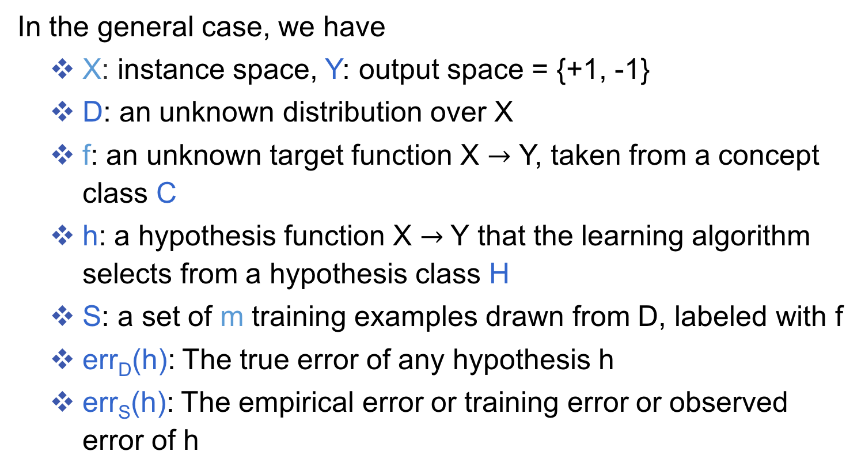
Formulating the theory of prediction
All the notation we have so far on one slide
In the general case, we have
X: instance space, Y: output space = {+1, -1}
D: an unknown distribution over X
f: an unknown target function X $→$ Y, taken from a concept class C
h: a hypothesis function X $→$Y that the learning algorithm selects from a hypothesis class H
S: a set of m training examples drawn from D, labeled with f
err_{D}(h): The true error of any hypothesis h
err_{S}(h): The empirical error or training error or observed error of h

Slide 92
Theoretical questions
Can we describe or bound the true error (err_{D}) given the empirical error (err_{S})?
Is a concept class C learnable?
Is it possible to learn C using only the functions in H using the supervised protocol?
How many examples does an algorithm need to guarantee good performance?

Slide 93
Requirements of Learning
Cannot expect a learner to learn a concept exactly
There will generally be multiple concepts consistent with the available data
Unseen examples could potentially have any label
We “agree” to misclassify uncommon examples that do not show up in the training set

Slide 94
Example

Slide 95
Example 2

Slide 96
Requirements of Learning
Cannot expect a learner to learn a concept exactly
There will generally be multiple concepts consistent with the available data
Unseen examples could potentially have any label
We “agree” to misclassify uncommon examples that do not show up in the training set
Cannot always expect to learn a close approximation to the target concept
Sometimes the training set will not be representative

Slide 97
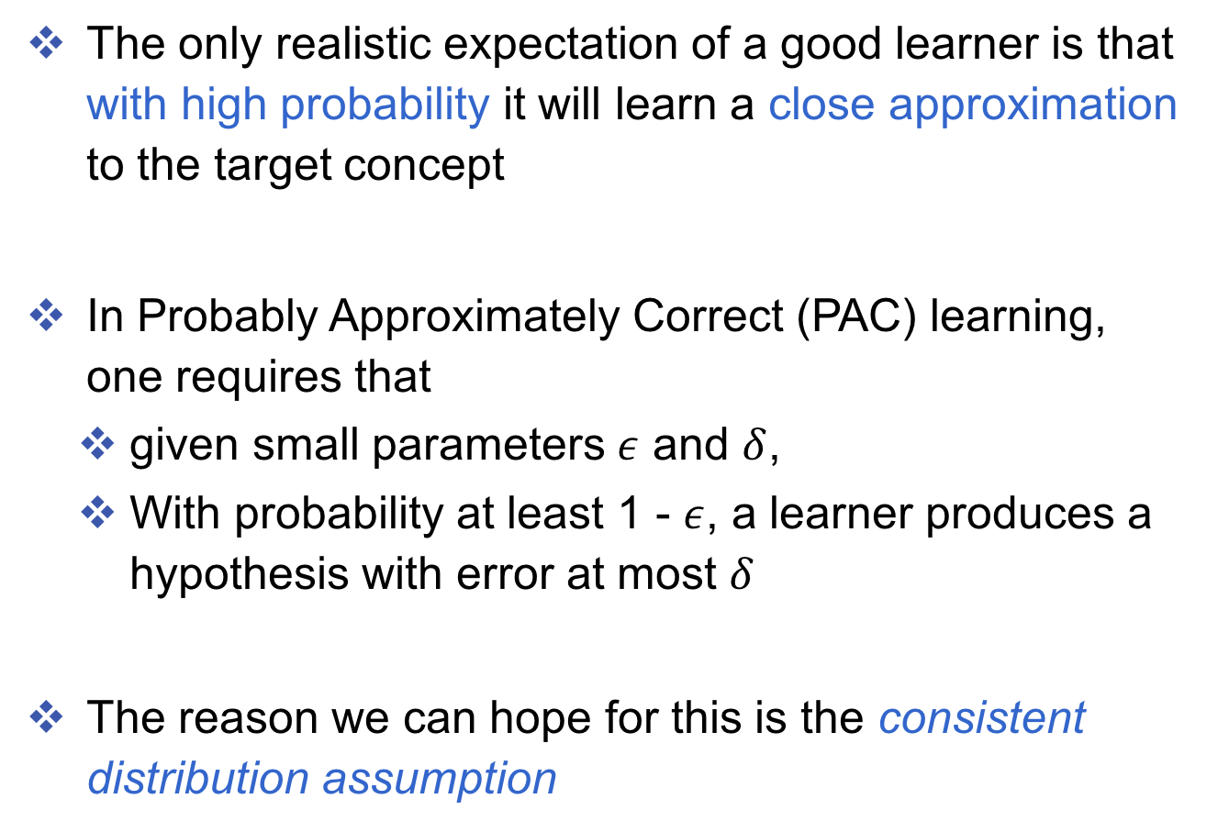
Probably approximately correctness
The only realistic expectation of a good learner is that with high probability it will learn a close approximation to the target concept
In Probably Approximately Correct (PAC) learning, one requires that
given small parameters $ε$ and $δ$,
With probability at least 1 - $ε$, a learner produces a hypothesis with error at most $δ$
The reason we can hope for this is the consistent distribution assumption

Slide 98
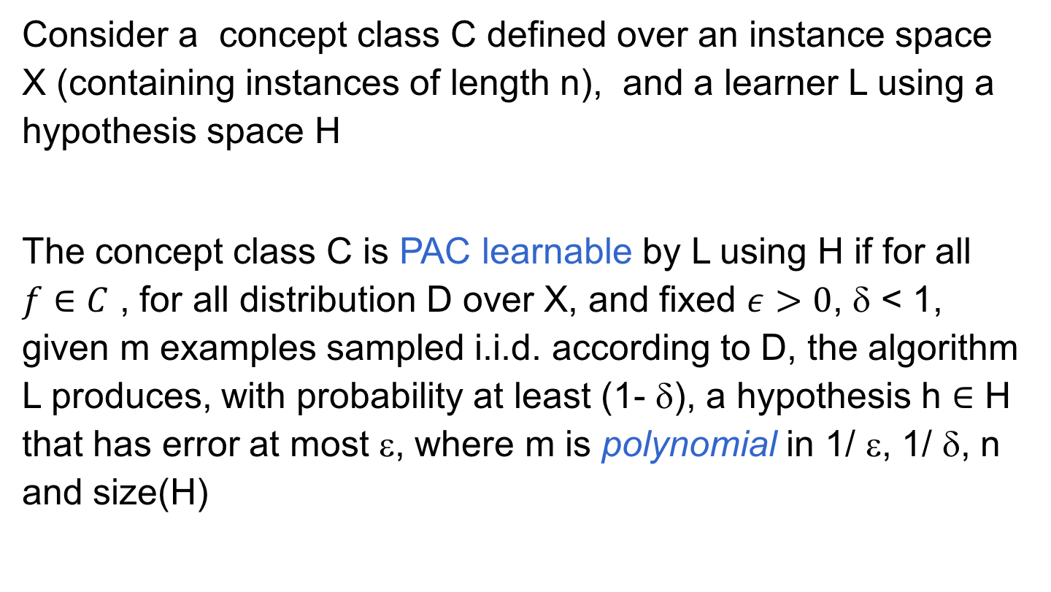
PAC Learnability
Consider a concept class C defined over an instance space X (containing instances of length n), and a learner L using a hypothesis space H
The concept class C is PAC learnable by L using H if for all $f∈C$ , for all distribution D over X, and fixed $ε>0$, δ < 1, given m examples sampled i.i.d. according to D, the algorithm L produces, with probability at least (1- δ), a hypothesis h $∈$ H that has error at most ε, where m is polynomial in 1/ ε, 1/ δ, n and size(H)

Slide 99
efficiently learnability
The concept class C is efficiently learnable if L can produce the hypothesis in time that is polynomial in 1/ ε, 1/ δ, n and size(H)

Slide 100
PAC Learnability
We impose two limitations
Polynomial sample complexity (information theoretic constraint)
Is there enough information in the sample to distinguish a hypothesis h that approximate f ?
Polynomial time complexity (computational complexity)
Is there an efficient algorithm that can process the sample and produce a good hypothesis h ?
Worst Case definition: the algorithm must meet its accuracy
for every distribution (The distribution free assumption)
for every target function f in the class C

Slide 101
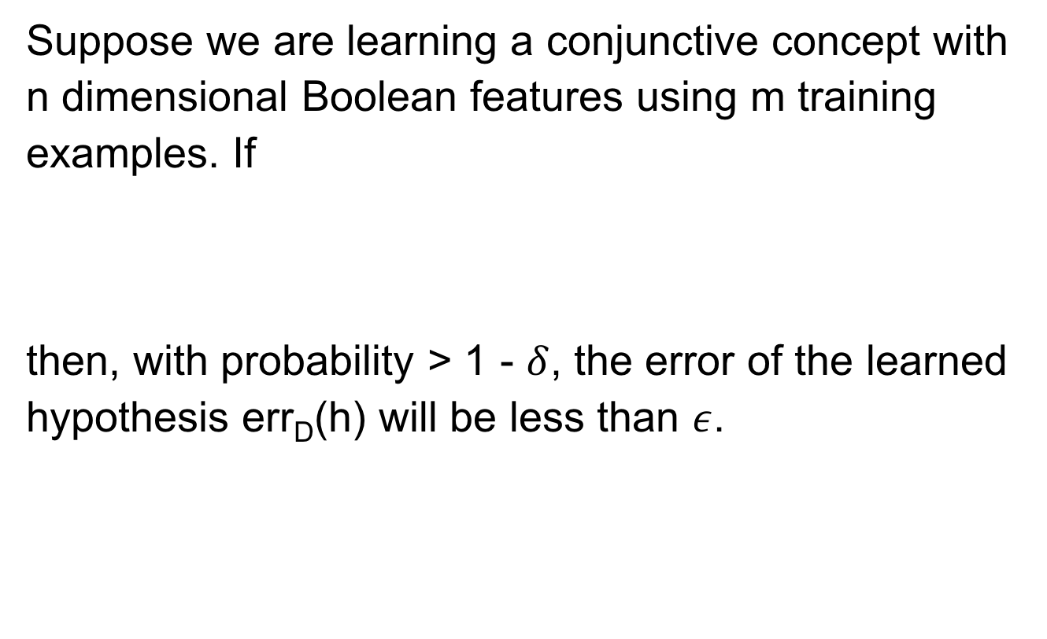
Example: Learning Conjunctions
Suppose we are learning a conjunctive concept with n dimensional Boolean features using m training examples. If
then, with probability > 1 - $δ$, the error of the learned hypothesis err_{D}(h) will be less than $ε$.
This term is often related to log (size(H)) if the learner is consistent
m is polynomial in 1/ ε, 1/ δ, n and size(H)

Slide 102
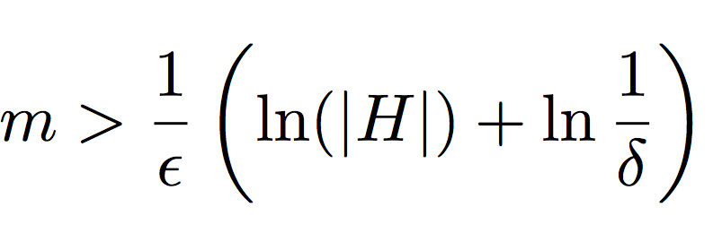
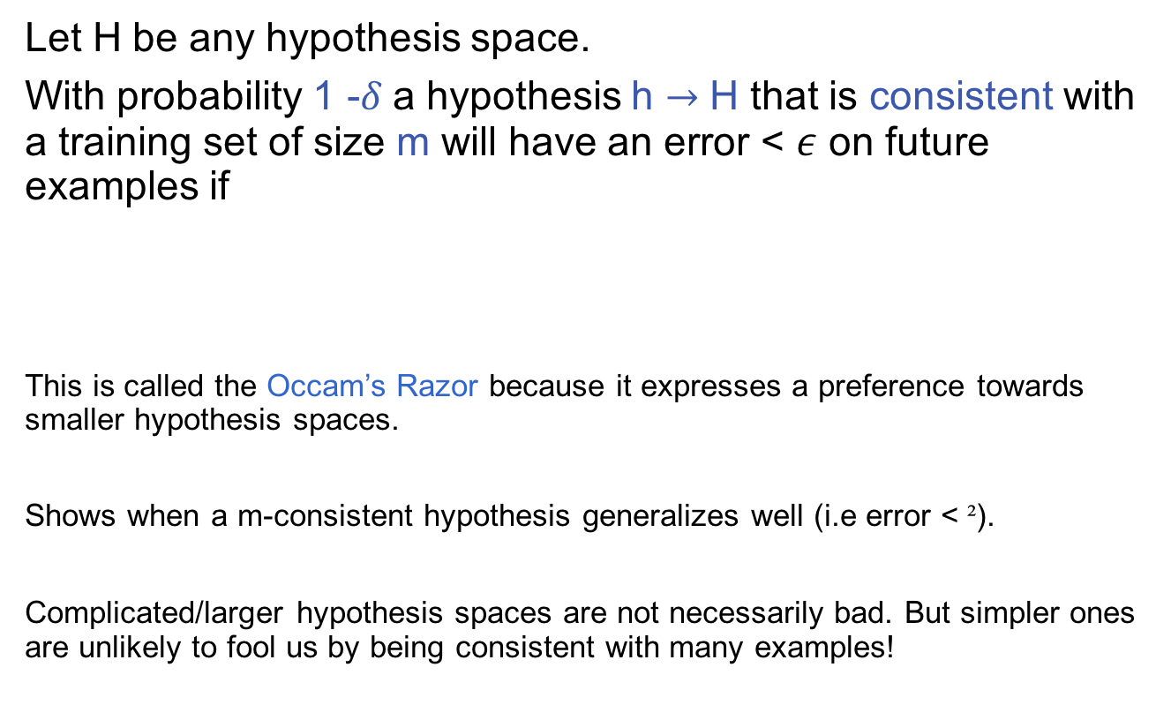
A general result
Let H be any hypothesis space.
With probability 1 -$δ$a hypothesis h $→$ H that is consistent with a training set of size m will have an error < $ε$ on future examples if
This is called the Occam’s Razor because it expresses a preference towards smaller hypothesis spaces.
Shows when a m-consistent hypothesis generalizes well (i.e error < ²).
Complicated/larger hypothesis spaces are not necessarily bad. But simpler ones are unlikely to fool us by being consistent with many examples!
1. Expecting lower error increases sample complexity (i.e more examples needed for the guarantee)
3. If we want a higher confidence in the classifier we will produce, sample complexity will be higher.
2. If we have a larger hypothesis space, then we will make learning harder (i.e higher sample complexity)

Slide 103
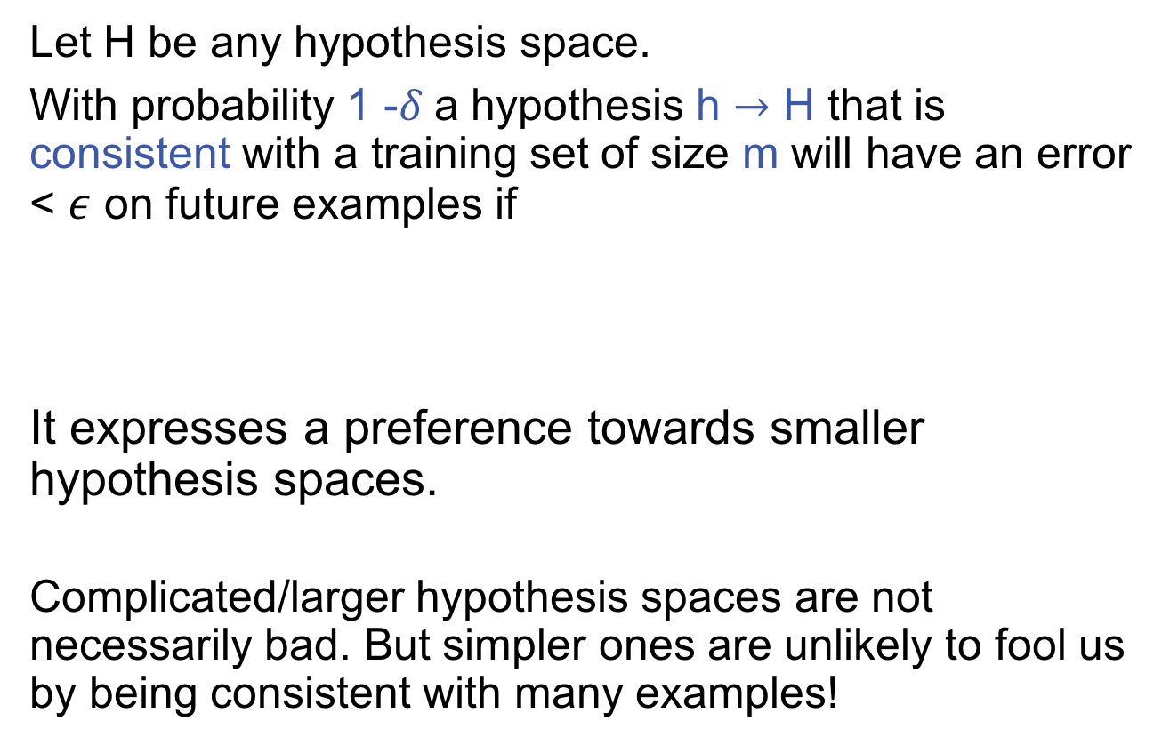
A general result
Let H be any hypothesis space.
With probability 1 -$δ$a hypothesis h $→$ H that is consistent with a training set of size m will have an error < $ε$ on future examples if
It expresses a preference towards smaller hypothesis spaces.
Complicated/larger hypothesis spaces are not necessarily bad. But simpler ones are unlikely to fool us by being consistent with many examples!

Slide 104
A general result
Let H be any hypothesis space.
With probability 1 -$δ$a hypothesis h $→$ H that is consistent with a training set of size m will have an error < $ε$ on future examples if
It expresses a preference towards smaller hypothesis spaces.
Complicated/larger hypothesis spaces are not necessarily bad. But simpler ones are unlikely to fool us by being consistent with many examples!
Next question: What if size(H) is infinity?

Slide 105
This lecture: Computational Learning Theory
The Theory of Generalization
Probably Approximately Correct (PAC) learning
Shattering and the VC dimension

Slide 106
Infinite Hypothesis Space
The previous analysis was restricted to finite hypothesis spaces
Some infinite hypothesis spaces are more expressive than others
Linear threshold function vs. a combination of LTUs
Need a measure of the expressiveness of an infinite hypothesis space other than its size

Slide 107
Vapnik-Chervonenkis dimension
The Vapnik-Chervonenkis dimension (VC dimension) provides such a measure
“What is the expressive capacity of a set of functions?”
Analogous to |H|, there are bounds for sample complexity using VC(H)

Slide 108
Learning Rectangles
Assume the target concept is an axis parallel rectangle
Y
X

Slide 109
Learning Rectangles
Assume the target concept is an axis parallel rectangle
Y
Points outside are negative
Points outside are negative
Points outside are negative
Points inside are positive
X
Points outside are negative

Slide 110
Learning Rectangles
Assume the target concept is an axis parallel rectangle
Y
+
+
-
X

Slide 111
Learning Rectangles
Assume the target concept is an axis parallel rectangle
Y
+
+
-
X

Slide 112
Learning Rectangles
Assume the target concept is an axis parallel rectangle
Y
+
+
-
+
+
X

Slide 113
Learning Rectangles
Assume the target concept is an axis parallel rectangle
Y
+
+
-
+
+
X

Slide 114
Learning Rectangles
Assume the target concept is an axis parallel rectangle
Y
+
+
+
-
+
+
+
+
+
+
+
X

Slide 115
Learning Rectangles
Assume the target concept is an axis parallel rectangle
Y
+
+
+
+
-
+
+
+
+
+
+
+
X

Slide 116
Learning Rectangles
Assume the target concept is an axis parallel rectangle
Y
+
+
+
+
-
+
+
+
+
+
+
+
X
Will we be able to learn the target rectangle?
Can we come close?
Key observation: Despite there are infinite # hypothesis
The blue & red rectangles have the same predictions

Slide 117
Let’s think about expressivity of functions
Suppose we have two points.
Can linear classifiers correctly classify any labeling of these points?
Linear functions are expressive enough to shatter 2 points

Slide 118
Let’s think about expressivity of functions
Suppose we have two points.
Can linear classifiers correctly classify any labeling of these points?
Linear functions are expressive enough to shatter 2 points

Slide 119
Shattering

Slide 120
Shattering

Slide 121
Shattering

Slide 122
Shattering
This particular labeling of the points can not be separated by any line

Slide 123
Shattering
This particular labeling of the points can not be separated by any line

Slide 124
Shattering
This particular labeling of the points can not be separated by any line

Slide 125
Shattering
This particular labeling of the points can not be separated by any line

Slide 126
Shattering
Linear functions are not expressive to shatter fourteen points
Because there is a labeling that can not be separated by them
Of course, a more complex function could separate them

Slide 127
Shattering
Definition: A set S of examples is shattered by a set of functions H if for every partition of the examples in S into positive and negative examples there is a function in H that gives exactly these labels to the examples
Intuition: A rich set of functions shatters large sets of points

Slide 128
Left bounded intervals
Example 1: Hypothesis class of left bounded intervals on the real axis: [0,a) for some real number a>0
+
+
+
+
+
-
-
+
+
+
+
+
-
0
a
0
-
a
+
Sets of two points cannot be shattered
That is: given two points, you can label them in such a way that no concept in this class will be consistent with their labeling

Slide 129
Real intervals
Example 2: Hypothesis class is the set of intervals on the real axis: [a,b],for some real numbers b>a
-
-
+
+
+
+
+
-
-
-
-
+
+
+
+
+
-
a
b
+
a
-
b
+
All sets of one or two points can be shattered
But some sets of three points cannot be shattered

